Slide 1
Collaborative Filtering in Recommender Systems

Slide 2
Collaborative filtering (CF) is one of the most widely used techniques in recommender systems.
It is based on the idea that users with similar preferences in the past will likely have similar preferences in the future.
The key assumption in collaborative filtering is that if two users have agreed on an item in the past, they are likely to agree on another item in the future.

Slide 3
Types of Collaborative Filtering
User-Based Collaborative Filtering
Item-Based Collaborative Filtering

Slide 4
User-Based Collaborative Filtering (UBCF)
User-based collaborative filtering recommends items by finding users with similar interests.
If User A and User B have similar preferences, and User A has liked a specific item, then that item is recommended to User B.

Slide 5
Steps in User-Based Collaborative Filtering
Create a User-Item Interaction Matrix
User ID | Item 101 | Item 102 | Item 103 | Item 104 | Item 105
1 | 5.0 | 3.0 | 4.0 | 0.0 | 0.0
2 | 4.0 | 0.0 | 0.0 | 5.0 | 0.0
3 | 0.0 | 2.0 | 5.0 | 0.0 | 3.0
4 | 4.0 | 0.0 | 0.0 | 0.0 | 2.0
5 | 0.0 | 0.0 | 5.0 | 4.0 | 0.0

Slide 6
Compute Similarity Between Users
Similarity is measured using metrics like:
  Cosine Similarity
  Pearson Correlation Coefficient
  Jaccard Similarity (for binary data)

Slide 7
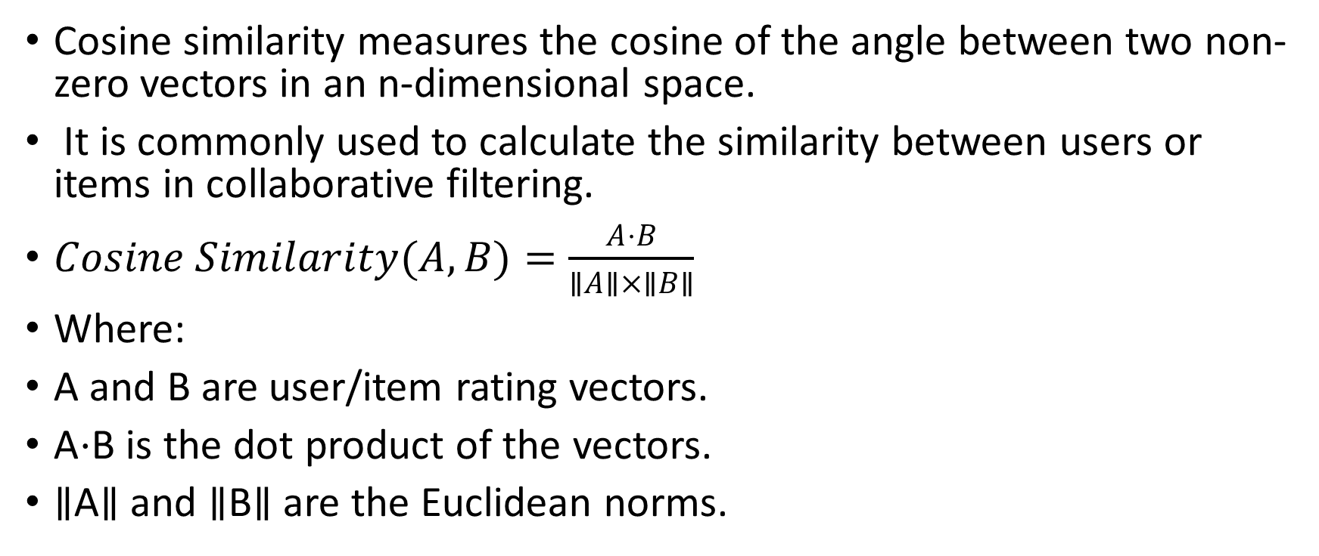
Cosine Similarity
Cosine similarity measures the cosine of the angle between two non-zero vectors in an n-dimensional space.
It is commonly used to calculate the similarity between users or items in collaborative filtering.
$Cosine Similarity(A,B)=\frac{A⋅B}{∥A∥×∥B∥}$
Where:
A and B are user/item rating vectors.
A⋅B is the dot product of the vectors.
∥A∥ and ∥B∥ are the Euclidean norms.

Slide 8
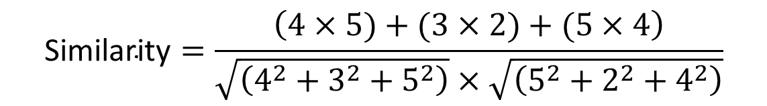
User/Item | Item 1 | Item 2 | Item 3
User A | 4 | 3 | 5
User B | 5 | 2 | 4
$$\text{Similarity}=\frac{\left(4×5)+(3×2)+(5×4\right)}{\sqrt{\left(4^{2}+3^{2}+5^{2}\right)}×\sqrt{\left(5^{2}+2^{2}+4^{2}\right)}}$$

Slide 9
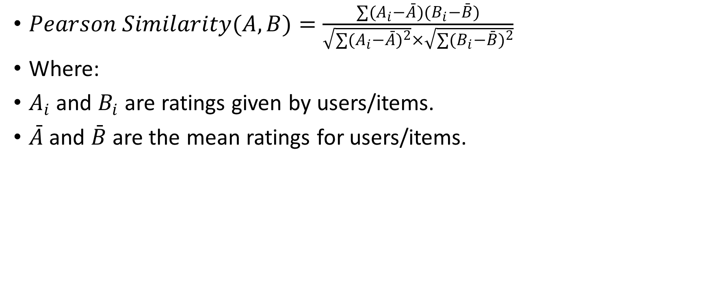
Pearson Correlation Coefficient
$Pearson Similarity(A,B)=\frac{∑(A_{i}−\overset{ˉ}{A})(B_{i}−\overset{ˉ}{B})}{\sqrt{∑(A_{i}−\overset{ˉ}{A})^{2}}×\sqrt{∑(B_{i}−\overset{ˉ}{B})^{2}}}$
Where:
$A_{i}$ and $B_{i}$ are ratings given by users/items.
$\overset{ˉ}{A}$and $\overset{ˉ}{B}$are the mean ratings for users/items.

Slide 10
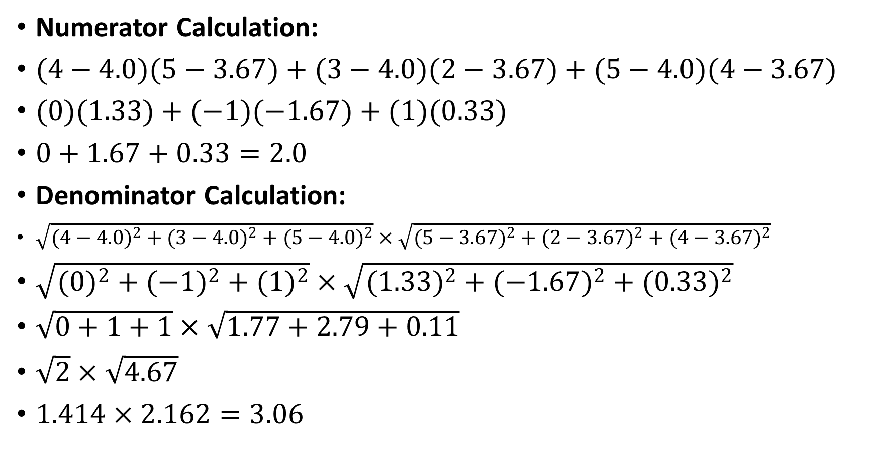
Numerator Calculation:
$(4−4.0)(5−3.67)+(3−4.0)(2−3.67)+(5−4.0)(4−3.67)$
$(0)(1.33)+(−1)(−1.67)+(1)(0.33)$
$0+1.67+0.33=2.0$
Denominator Calculation:
$\sqrt{(4−4.0)^{2}+(3−4.0)^{2}+(5−4.0)^{2}}×\sqrt{(5−3.67)^{2}+(2−3.67)^{2}+(4−3.67)^{2}}$
$\sqrt{(0)^{2}+(−1)^{2}+(1)^{2}}×\sqrt{(1.33)^{2}+(−1.67)^{2}+(0.33)^{2}}$
$\sqrt{0+1+1}×\sqrt{1.77+2.79+0.11}$
$\sqrt{2}×\sqrt{4.67}$
$1.414×2.162=3.06$

Slide 11

Compute Final Pearson Correlation Coefficient
$r(A,B)=\frac{2.0}{3.06}=0.654$
Pearson Correlation Coefficient = 0.654
→ Moderate positive correlation

Slide 12
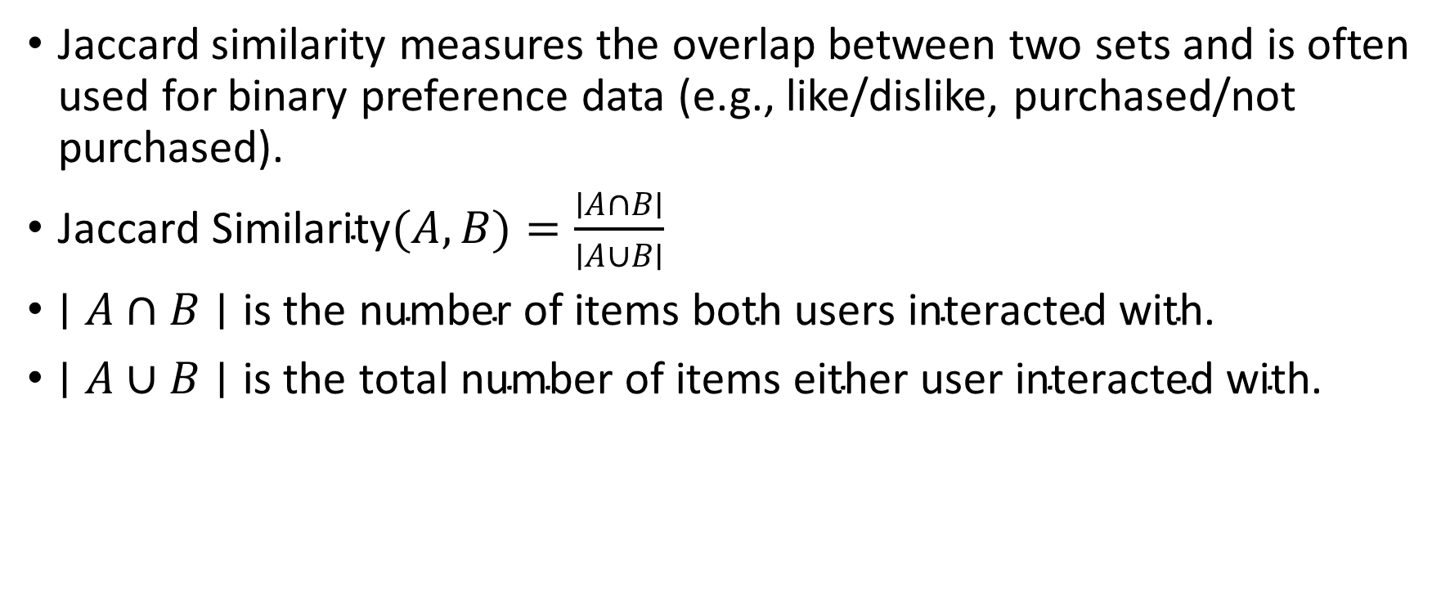
Jaccard Similarity (For Binary Data)
Jaccard similarity measures the overlap between two sets and is often used for binary preference data (e.g., like/dislike, purchased/not purchased).
$\text{Jaccard} \text{Similarity}(A,B)=\frac{∣A∩B∣}{∣A∪B∣}$
$∣A∩B∣\text{is} \text{the} \text{number} \text{of} \text{items} \text{both} \text{users} \text{interacted} \text{with}\text{.}$
$∣A∪B∣\text{is} \text{the} \text{total} \text{number} \text{of} \text{items} \text{either} \text{user} \text{interacted} \text{with}\text{.}$

Slide 13
User/Item | Item 1 | Item 2 | Item 3 | Item 4
User A | 1 | 0 | 1 | 1
User B | 1 | 1 | 1 | 0
$$\text{Jaccard} \text{Similarity}=\frac{\left(1+1\right)}{\left(1+0+1+1+1+1+1+0\right)}=\frac{2}{5}=0.4$$
Jaccard similarity ranges from 0 (no similarity) to 1 (identical sets).

Slide 14
Content-based recommender system
A Content-Based Recommender System suggests items to users by analyzing the attributes of items and matching them with a user's preferences.
It relies on item descriptions and user history rather than collaborative filtering.
Similarity Computation: The system calculates similarity between items using techniques like: Cosine Similarity (for text-based attributes)
TF-IDF (Term Frequency-Inverse Document Frequency) (for document-based recommendations)
Euclidean Distance (for numerical features)

Slide 15
TF-IDF Calculation for Movie Keywords
Movie 1: "A superhero fights villains to save the city."
Movie 2: "A masked vigilante battles criminals to protect his town.“
We extract key terms:Keywords: ["superhero", "villains", "city", "masked", "vigilante", "criminals", "town"]

Slide 16
Word | Movie 1 (A) | Movie 2 (B)
Superhero | 1 | 0
Villains | 1 | 0
City | 1 | 1
Masked | 0 | 1
Vigilante | 0 | 1
Criminals | 0 | 1
Town | 1 | 1

Slide 17

Step 1: Compute TF (Term Frequency)
$TF=\frac{Occurrences of word in document}{Total words in document}$
Word | TF (Movie 1) | TF (Movie 2)
Superhero | 1/7=0.14291/7 = 0.14291/7=0.1429 | 0/7=0.00000/7 = 0.00000/7=0.0000
Villains | 1/7=0.14291/7 = 0.14291/7=0.1429 | 0/7=0.00000/7 = 0.00000/7=0.0000
City | 1/7=0.14291/7 = 0.14291/7=0.1429 | 1/7=0.14291/7 = 0.14291/7=0.1429
Masked | 0/7=0.00000/7 = 0.00000/7=0.0000 | 1/7=0.14291/7 = 0.14291/7=0.1429
Vigilante | 0/7=0.00000/7 = 0.00000/7=0.0000 | 1/7=0.14291/7 = 0.14291/7=0.1429
Criminals | 0/7=0.00000/7 = 0.00000/7=0.0000 | 1/7=0.14291/7 = 0.14291/7=0.1429
Town | 1/7=0.14291/7 = 0.14291/7=0.1429 | 1/7=0.14291/7 = 0.14291/7=0.1429
Word | TF (Movie 1) | TF (Movie 2)
Superhero | 1/7=0.1429 | 0/7=0.0000
Villains | 1/7=0.1429 | 0/7=0.0000
City | 1/7=0.1429 | 1/7=0.1429
Masked | 0/7=0.0000 | 1/7=0.1429
Vigilante | 0/7=0.0000 | 1/7=0.1429
Criminals | 0/7=0.0000 | 1/7=0.1429
Town | 1/7=0.1429 | 1/7=0.1429

Slide 18
Compute IDF (Inverse Document Frequency)
Suppose we have 10 total movies in the dataset and the number of movies containing each word is:
Word | # of Movies Containing Word
Superhero | 3
Villains | 4
City | 6
Masked | 2
Vigilante | 2
Criminals | 3
Town | 5

Slide 19
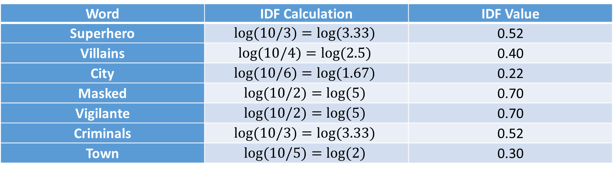

$IDF=log\left(\frac{10}{Number of movies with term}\right)$
Word | IDF Calculation | IDF Value
Superhero | $$log(10/3)=log(3.33)$$ | 0.52
Villains | $$log(10/4)=log(2.5)$$ | 0.40
City | $$log(10/6)=log(1.67)$$ | 0.22
Masked | $$log(10/2)=log(5)$$ | 0.70
Vigilante | $$log(10/2)=log(5)$$ | 0.70
Criminals | $$log(10/3)=log(3.33)$$ | 0.52
Town | $$log(10/5)=log(2)$$ | 0.30

Slide 20
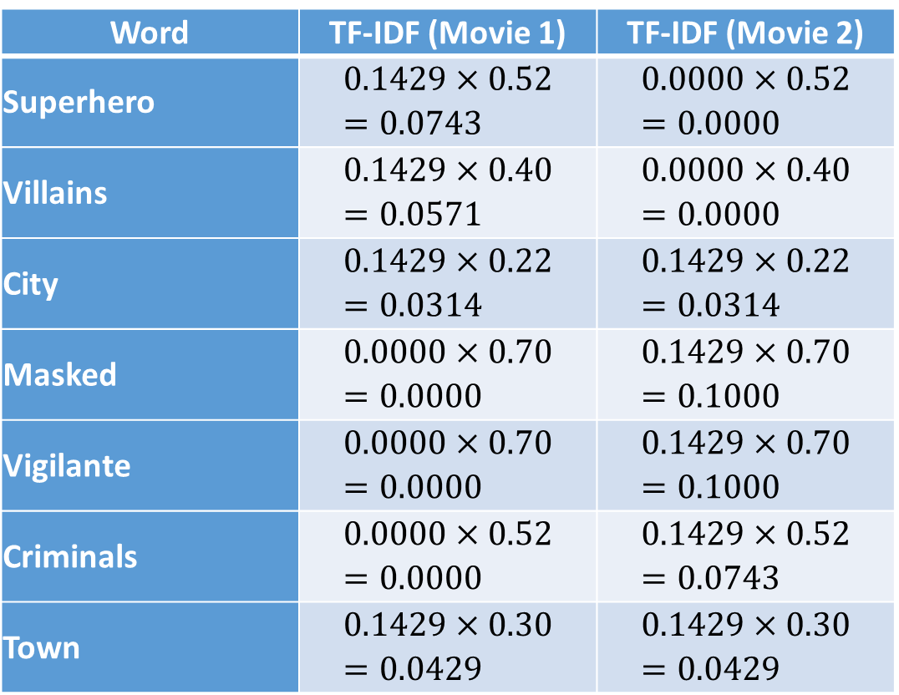

Compute TF-IDF
Word | TF-IDF (Movie 1) | TF-IDF (Movie 2)
Superhero | $$0.1429×0.52=0.0743$$ | $$0.0000×0.52=0.0000$$
Villains | $$0.1429×0.40=0.0571$$ | $$0.0000×0.40=0.0000$$
City | $$0.1429×0.22=0.0314$$ | $$0.1429×0.22=0.0314$$
Masked | $$0.0000×0.70=0.0000$$ | $$0.1429×0.70=0.1000$$
Vigilante | $$0.0000×0.70=0.0000$$ | $$0.1429×0.70=0.1000$$
Criminals | $$0.0000×0.52=0.0000$$ | $$0.1429×0.52=0.0743$$
Town | $$0.1429×0.30=0.0429$$ | $$0.1429×0.30=0.0429$$
$TF−IDF=TF×IDF$

Slide 21
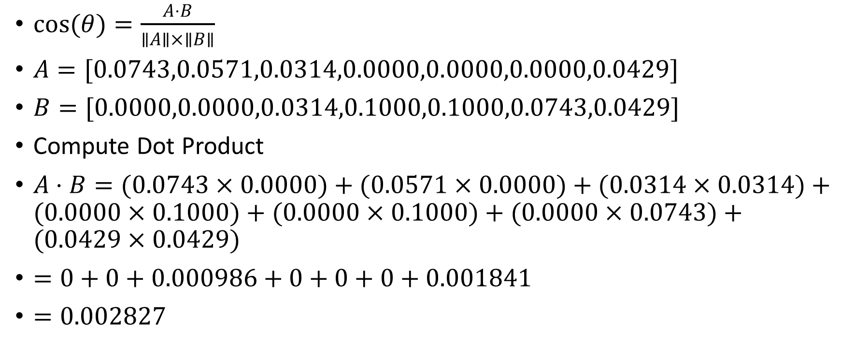
Understanding Cosine Similarity
$cos(θ)=\frac{A⋅B}{∥A∥×∥B∥}$
$A=[0.0743,0.0571,0.0314,0.0000,0.0000,0.0000,0.0429]$
$B=[0.0000,0.0000,0.0314,0.1000,0.1000,0.0743,0.0429]$
Compute Dot Product
$A⋅B=(0.0743×0.0000)+(0.0571×0.0000)+(0.0314×0.0314)+(0.0000×0.1000)+(0.0000×0.1000)+(0.0000×0.0743)+(0.0429×0.0429)$
$=0+0+0.000986+0+0+0+0.001841$
$=0.002827$

Slide 22
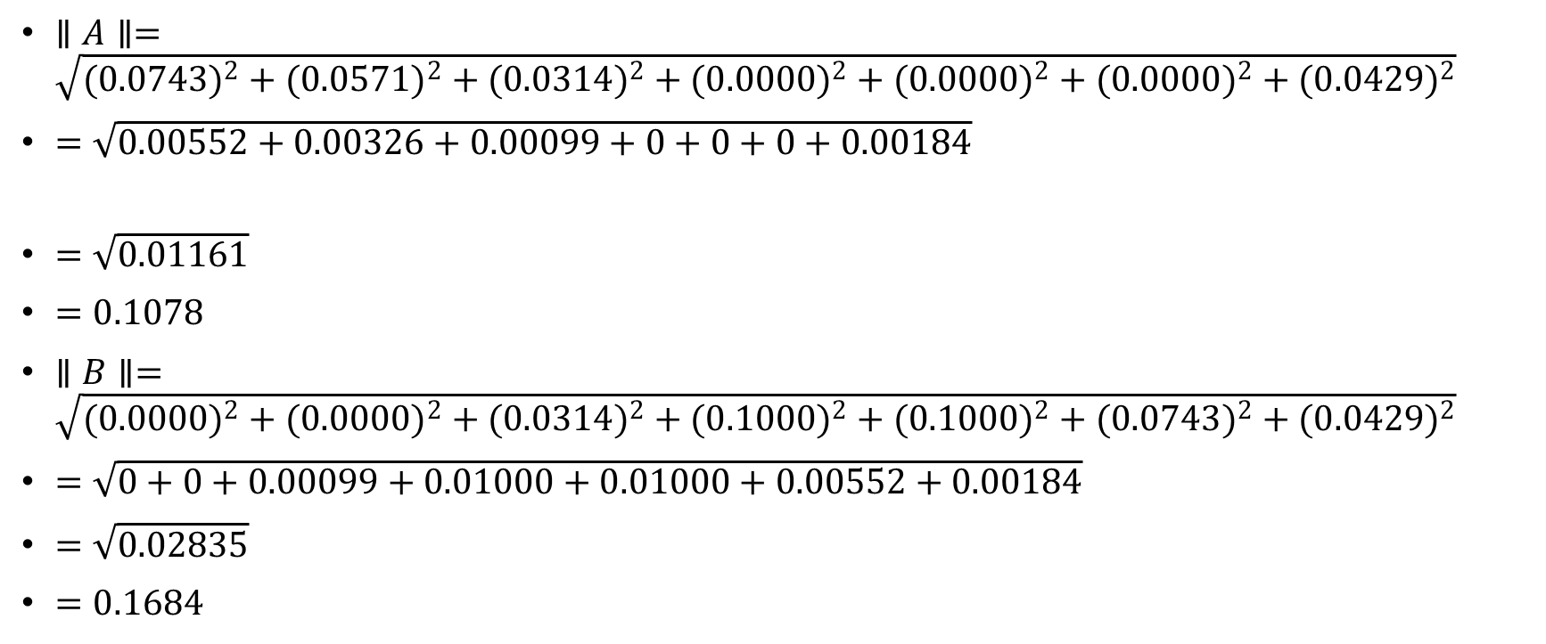
$∥A∥=\sqrt{(0.0743)^{2}+(0.0571)^{2}+(0.0314)^{2}+(0.0000)^{2}+(0.0000)^{2}+(0.0000)^{2}+(0.0429)^{2}}$
$=\sqrt{0.00552+0.00326+0.00099+0+0+0+0.00184}$
$=\sqrt{0.01161}$
$=0.1078$
$∥B∥=\sqrt{(0.0000)^{2}+(0.0000)^{2}+(0.0314)^{2}+(0.1000)^{2}+(0.1000)^{2}+(0.0743)^{2}+(0.0429)^{2}}$
$=\sqrt{0+0+0.00099+0.01000+0.01000+0.00552+0.00184}$
$=\sqrt{0.02835}$
$=0.1684$

Slide 23
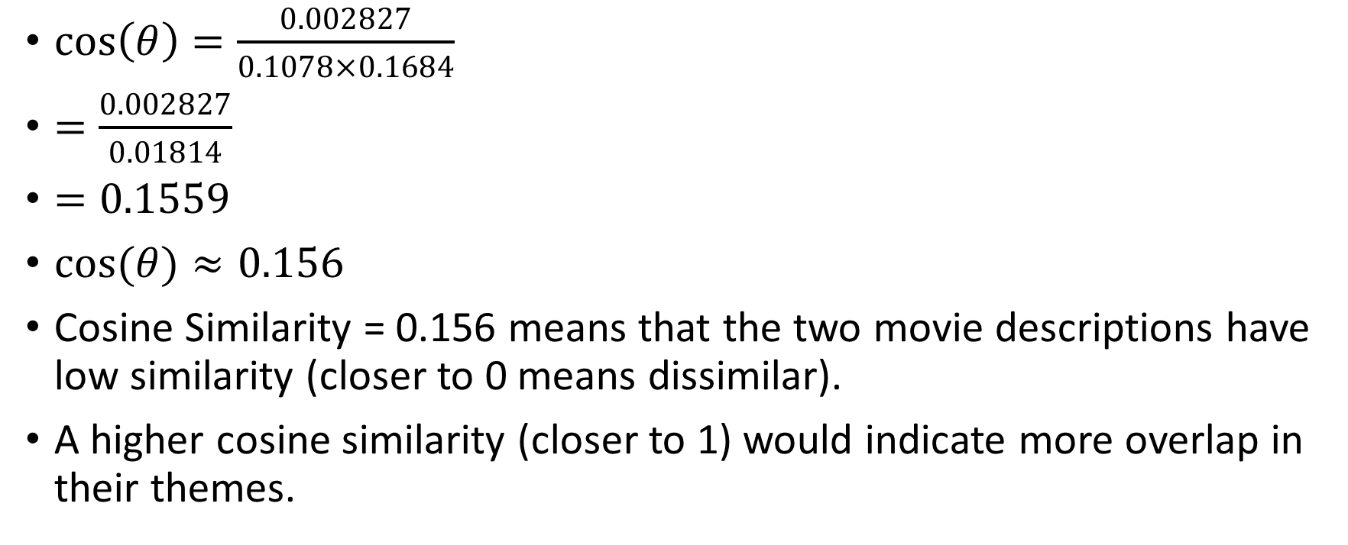
$cos\left(θ\right)=\frac{0.002827}{0.1078×0.1684}$
$=\frac{0.002827}{0.01814}$
$=0.1559$
$cos(θ)≈0.156$
Cosine Similarity = 0.156 means that the two movie descriptions have low similarity (closer to 0 means dissimilar).
A higher cosine similarity (closer to 1) would indicate more overlap in their themes.

